Slide 1
Logistic Regression

Slide 2
So far…
Simple linear regression
Single feature
Single dependent continuous variable
Linear equation
Multiple regression
Multiple features
Single dependent continuous variable
Linear equation
what to do when …
When the dependent variable is not continuous
When relationship is not linear

Slide 3
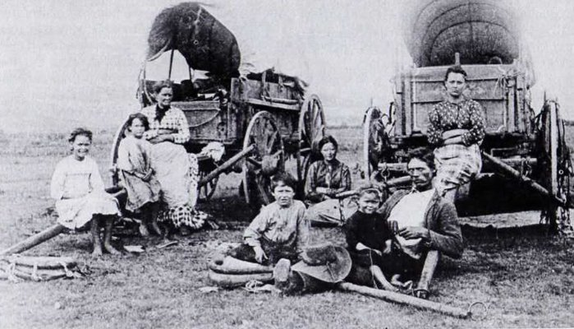
Donner Party (1846)
During the summer of 1846, the 87 members of the Donner Party started their journey to California.
Lansford W. Hastings in a popular and influential guidebook route
By the time the last member of the party was rescued, 40 had died.
Notes:
Ref : https://history.msu.edu/hst321/files/2010/07/grayson.pdf

Slide 4
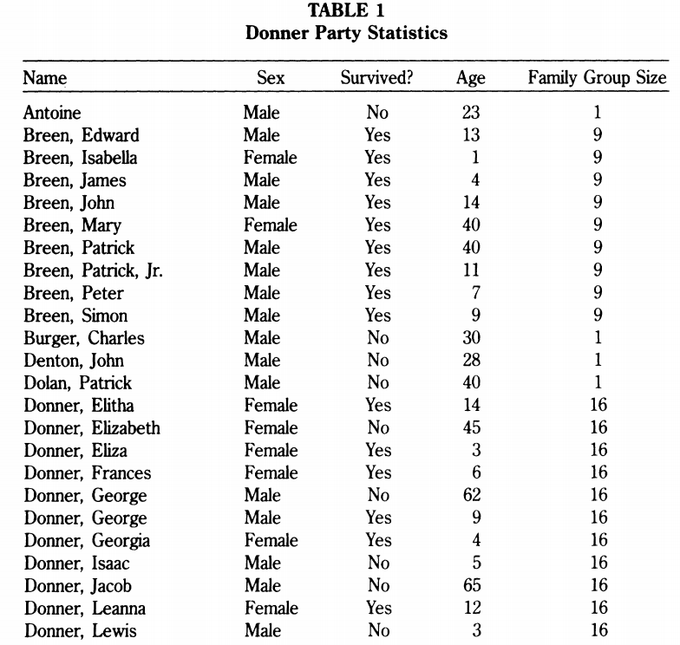
Data

Slide 5
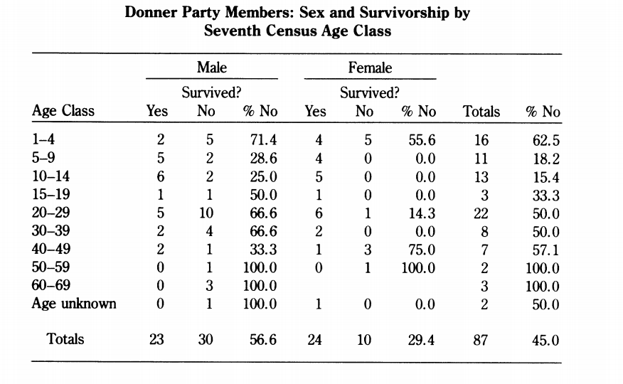
Survived?

Slide 6
Problem Setup
It seems clear that both age and gender have an effect on someone’s survival, how do we come up with a model that will let us explore this relationship?
Independent Variables : Age , Sex
Dependent Variable : Survived? {Yes, No}

Slide 7

Fitting linear regression
What are we modelling? Value or probability?
Dependent Variable (y) is restricted in {0,1} . For any value of X, output should be probability of event.
difficult to decipher a relationship among these variables.
non-normally distributed dependent variable
The error terms are heteroskedastic. [ error is not normally distributed because y takes on only two values]
The predicted probabilities can be greater than 1 or less than 0
Linear Model
y
Yes
$$x^{new}$$
Binary Outcome
x
No
In the linear regression:
y = β₀ + β₁X + e ; where Y = (0, 1)

Slide 8




Probability And Odds
The odds has a range of 0 to ∞ with values greater than 1 associated with an event being more likely to occur than to not occur and values less than 1 associated with an event that is less likely to occur than not occur.
Notes:
Dice roll of 1: probability = 1/6, odds = 1/5
Even dice roll: probability = 3/6, odds = 3/3 = 1
Heart Disease : 1 in 6
Cancer : 1 in 7
Suicide : 1 in 88
Accident : 1 in 103
Fall : 1 in 114
Pedestrian Accident : 1 in 556
Drowning : 1 in 1,117
Choking on Food : 1 in 2,696
Sharp objects : 1 in 28,000
Storm : 1 in 31,394
Hot surfaces and substances : 1 in 46,045
Hornet, wasp and bee stings : 1 in 46,562
Dog attack : 1 in 115,111
Passenger on an airplane : 1 in 188,364
Lightning : 1 in 218,106
Railway passenger : 1 in 243,765

Slide 9
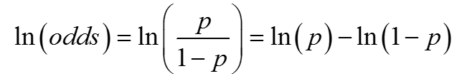
Logit
The logit is defined as the log of the odds
It creates a variable with a range from -∞ to +∞. Range of the logit is not restricted like probability {0,1}
The interpretation of logits is simple—take the exponential of the logit and you have the odds for the two groups in question.

Slide 10

From Linear to Logistic
Linear regression:
continuous response is modeled as a linear combination of the features:
y=β0+β1x
Logistic regression:
log-odds of a categorical response (being "true" ~1) is modeled as a linear combination of the features:
ln(p/1−p)=β0+β1x
The equation can be rearranged into the logistic function:
p =

Slide 11
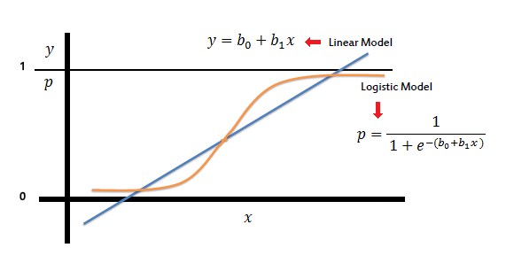
Logistic Regression
The logistic distribution constrains the estimated probabilities to lie between 0 and 1.
if you let β₀ + β₁X =0, then p = .50
as β0 + β1X gets really big, p approaches 1
as β0 + β1X gets really small, p approaches 0
Logistic regression outputs the probabilities of a specific class
Those probabilities can be converted into class predictions

Slide 12
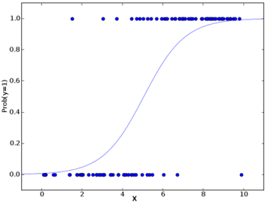
Logistic Regression
Name is somewhat misleading. Really a technique for classification, not regression. technique for classification, not regression.
Involves a more probabilistic view of classification.
Notes:
Ref ; http://courses.washington.edu/css490/2012.Winter/lecture_slides/05b_logistic_regression.pdf

Slide 13
About…
A multidimensional feature space (features A multidimensional feature space (features can be categorical or continuous).
Outcome is discrete. We’ll focus on case of two classes first. This can be extended to many classes.
It seems plausible that a linear decision boundary will give good predictive accuracy.
Can interpret prediction from a logistic regression model as model as probability of class membership.

Slide 14
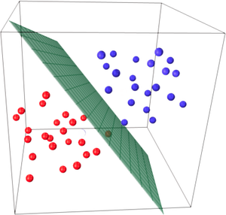
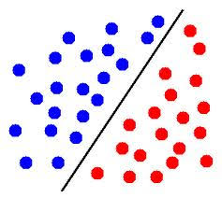
Linearly Separable
Logistic regression assumes that your input space can be separated into two ‘regions’, one for each class, by a linear boundary.

Slide 15
Advantages
Natural probabilistic view of class predictions.
Easily extended to multiple classes.
Good accuracy for many simple data sets.
Resistant to overfitting.
Quick to train.
Can interpret model coefficients as indicators of feature importance.

Slide 16

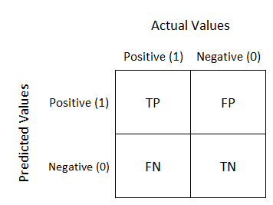

Confusion Matrix - Accuracy
Notes:
Ref : https://towardsdatascience.com/understanding-confusion-matrix-a9ad42dcfd62
https://developers.google.com/machine-learning/crash-course/classification/accuracy

Slide 17

Accuracy Example
Accuracy=TP+TNTP+TN+FP+FN=1+901+90+1+8=0.91
True Positive (TP):Reality: Malignant ML model predicted: Malignant Number of TP results: 1 | False Positive (FP):Reality: Benign ML model predicted: Malignant Number of FP results: 1
False Negative (FN):Reality: Malignant ML model predicted: Benign Number of FN results: 8 | True Negative (TN):Reality: Benign ML model predicted: Benign Number of TN results: 90

Slide 18

Precision
What proportion of positive identifications was actually correct?
True Positives (TPs): 1 | False Positives (FPs): 1
False Negatives (FNs): 8 | True Negatives (TNs): 90

Slide 19

Recall
What proportion of actual positives was identified correctly?
True Positives (TPs): 1 | False Positives (FPs): 1
False Negatives (FNs): 8 | True Negatives (TNs): 90

Slide 20
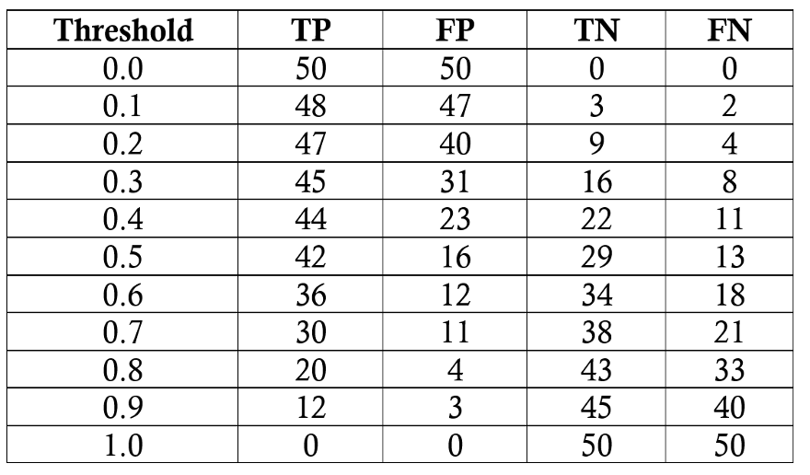
Threshold

Slide 21
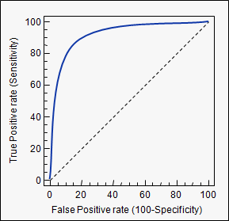

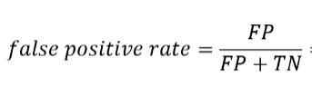

ROC Curve

Slide 22
“People worry that computers will get too smart and take over the world, but the real problem is that they're too stupid and they've already taken over the world.”
― Pedro Domingos

Slide 23
Thanks!

